Slide 1
Introduction to Psychological Disorders

Slide 2

Psychological disorders are:
patterns of thoughts, feelings, or actions that are deviant, distressful, and dysfunctional.
Terms from the Definition
Disorder refers to a state of mental/behavioral ill health.
Patterns refers to finding a collection of symptoms that tend to go together, and not just seeing a single symptom.
For there to be distress and dysfunction, symptoms must be sufficiently severe to interfere with one’s daily life and well being.
Deviant means differing from the norm.
Notes:
1)“disorder” is used instead of “disease” because the latter term typically implies a known cause of the symptoms. In naming a disorder you are naming the collection of symptoms that tend to go together.
2) pattern vs. single symptom: one of the symptoms of brain cancer is a headache. If you have a headache, though, it would be a mistake to assume that you have brain cancer. Similarly, one of the symptoms of major depression may be that you feel sad. If you feel sad, though, this is not enough to qualify for diagnosis of major depressive disorder. Keep this in mind when we discuss ADHD.
3) Distress = internal anguish.
4) Dysfunction = impact of the psychological disorder on a person’s ability to manage day-to-day tasks and relationships. For examples, severe depression or anxiety might prevent you from feeling able to go to work or school. Personality disorders create problems in relationships.
5) Although the definition says “distress and dysfunction,” in some disorders only one of these will really stand out. Some personality disorders, as well as substance abuse, involve dysfunction without distress. Some anxiety disorders can involve distress without any dysfunction that others will notice.
6) More about deviance coming up. Another common term is “ abnormal,” which more literally means varying from the norm. Both of these terms have acquired an unnecessarily negative connotation outside the field of psychology.

Slide 3

“Deviant”?
Defining Deviance: The Role of Context and Culture
Context: whether a behavior varies from expectation depends on the situation in which the behavior occurs →Yelling for hours is not deviant when it happens at a football game.
Culture: these painted faces might seem deviant when viewed from a different culture
To deviate, in general, means to vary from what typically would happen.
In psychology, a behavior or mental state is considered deviant by a culture when it is different from what would be expected in that culture.
A disorder may also be a deviation from a typical developmental pathway.
Notes:
Deviation from a developmental pathway includes autism, mental retardation, or extremely disruptive behavior which persists in all situations.
To deviate from the norm is not enough to define a disorder. The genius, a champion athlete, and the nonconformist all deviate from the norm but do not necessarily have a disorder.

Slide 4
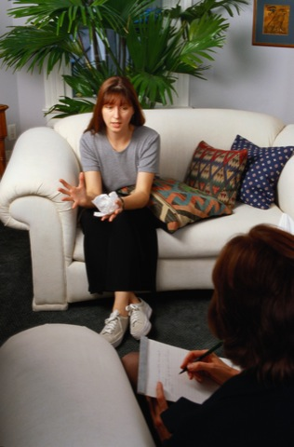
The Medical Model
Psychological disorders can be seen as psychopathology, an illness of the mind.
Disorders can be diagnosed, labeled as a collection of symptoms that tend to go together.
People with disorders can be treated, attended to, given therapy, all with a goal of restoring mental health.
Notes:
The medical model assumes that psychological disorders are mental illnesses with physical causes that can be diagnosed, treated, and, in most cases, cured through therapy, sometimes in a hospital
The medical model also implies ideas about etiology, the cause of mental disorders. It is not always possible to determine the cause of a specific mental disorder, but in general, the assumption here is that the cause is physical and mental, and not spiritual.

Slide 5
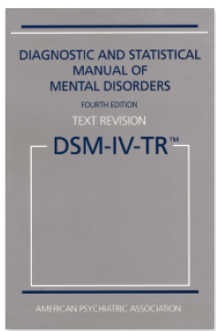
Classifying Psychological Disorders
The Diagnostic and Statistical Manual
It’s easier to count cases of autism if we have a clear definition.
Versions: DSM-V (2013)
The DSM is used to justify payment for treatment.
It’s consistent with diagnoses used by medical doctors worldwide.
Why create classifications of mental illness? What is the value of talking about diagnoses instead of just talking about individuals?
Diagnoses create a verbal shorthand for referring to a list of associated symptoms.
Diagnoses allow us to statistically study many similar cases, learning to predict outcomes.
Diagnoses can guide treatment choices.
Notes:
In order to make the definitions clear, each diagnosis in the DSM includes lists of symptoms, often in groups. The DSM includes criteria about how many symptoms must be present in each category to justify a label.

Slide 6
Critiques of Diagnosing with the DSM
1. The DSM calls too many people “disordered.”
The border between diagnoses, or between disorder and normal, seems arbitrary.
Decisions about what is a disorder seem to include value judgments; is depression necessarily deviant?
Diagnostic labels direct how we view and interpret the world, telling us which behavior and mental states to see as disordered.
Notes:
A fundamental problem with the diagnostic labeling of psychologically disordered behaviors is that the labels often bias our perceptions of the labeled person.
The first critique has been raised about the DSM 5 in particular, including the possibility that some depression that is part of a grieving process may be more likely to be called a disorder (implying that it needs to be treated).
Valid, reliable criteria might address this concern.
In an older DSM, homosexuality was considered a disorder. In the current and future versions, there are more adult labels for symptoms more likely to be evident in females, such as anxiety and depression, and fewer “male” diagnoses (such as diagnoses that relate to the emotion of anger).
See if students can connect the impact of diagnoses to the general impact of having schema, concepts and categories that organize and influence our perceptions. (Rosenhan study)/

Slide 7
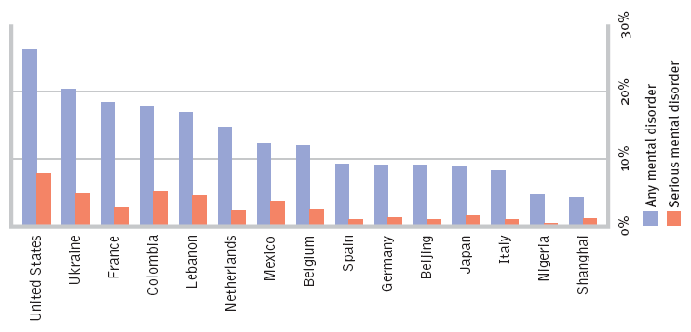

How common are psychological disorders?
Countries vary greatly in the percentage of people reporting mental health issues in the past year.
Notes:
No animation.
Depression and schizophrenia are found all over the world. Bulimia, however appears mostly in the United States and pockets of Americanized culture elsewhere.
What can this mean about the US?

Slide 8
Anxiety Disorders

Slide 9
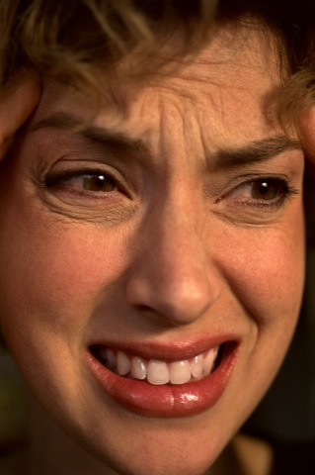
Anxiety Disorders
GAD: Generalized anxiety disorder
Panic disorder
Phobias
OCD: Obsessive-compulsive disorder
PTSD: Post-traumatic stress disorder
Notes:
Generalized anxiety disorder, in which a person is unexplainably and continually tense and uneasy
Panic disorder, in which a person experiences sudden episodes of intense dread
Phobias, in which a person is intensely and irrationally afraid of a specific object, activity, or situation
Obsessive-compulsive disorder, in which a person is troubled by repetitive thoughts and/or actions
Post-traumatic stress disorder, in which a person has lingering memories, nightmares, and other symptoms for weeks after a severely threatening, uncontrollable event

Slide 10

GAD: Generalized Anxiety Disorder
Emotional-cognitive symptoms include worrying, having anxious feelings and thoughts about many subjects, and sometimes “free-floating” anxiety with no attachment to any subject. Anxious anticipation interferes with concentration.
Physical symptoms include autonomic arousal, trembling, sweating, fidgeting, agitation, and sleep disruption.
Notes:
Free floating- not being able to idetify the source of anxiety
GAD tends to occur along with mild but persistent depression.
GAD becomes more rare after age 50. Why might that be? Perhaps experience shows that things usually don’t turn out as badly as those with Generalized Anxiety Disorder think they will.
Prevalence about 3%
Affects more women than men

Slide 11
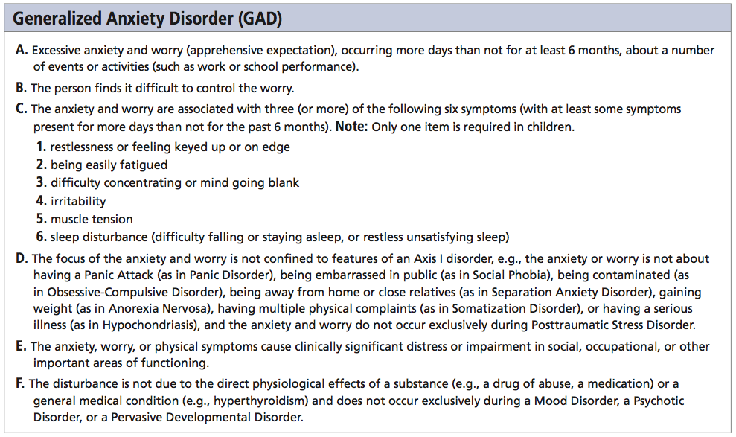
GAD: DSM Criteria
Notes:
I will not test you on DSM criteria

Slide 12

Panic Disorder: “I’m Dying”
A panic attack is not just an “anxiety attack.” It may include:
many minutes of intense dread or terror.
chest pains, choking, numbness, or other frightening physical sensations. Patients may feel certain that it’s a heart attack.
a feeling of a need to escape.
Panic disorder refers to repeated and unexpected panic attacks, as well as a fear of the next attack, and a change in behavior to avoid panic attacks.
Notes:
Panic disorder includes the fight or flight system, and easy triggering of the autonomic nervous system.
In a panic attack, the mind fills in an explanation: “If I’m feeling terror and a physical response to a threat, there must be some danger here.” People sometimes attribute the panic to whatever situation was present when the attack occurred.
Extreme avoidance of possible panic triggers agoraphobia, an anxiety disorder characterized by anxiety in situations where the sufferer perceives the environment to be difficult or embarrassing to escape, such as wide-open spaces.

Slide 13
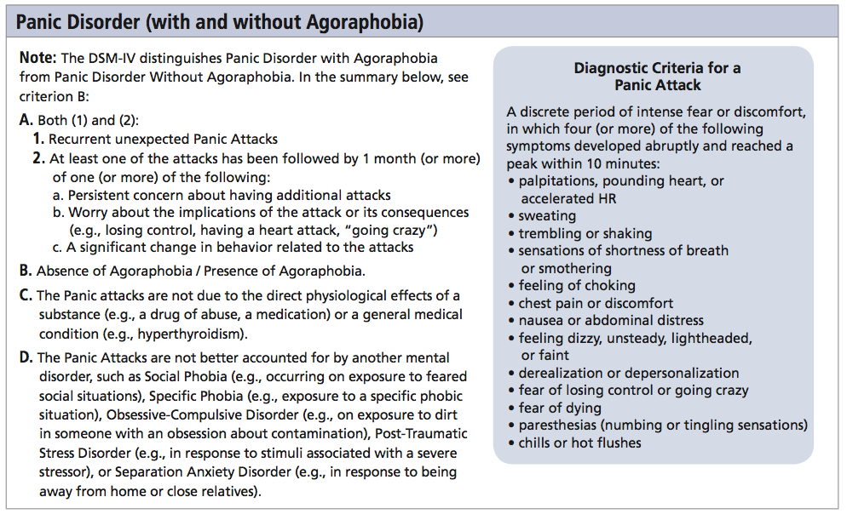
Panic Disorder: DSM Criteria

Slide 14
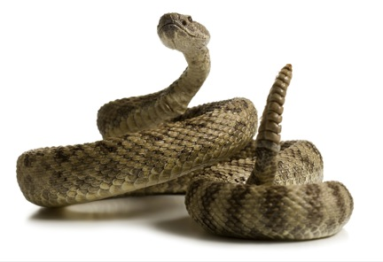
Specific Phobia
A specific phobia is more than just a strong fear or dislike. A specific phobia is diagnosed when there is an uncontrollable, irrational, intense desire to avoid the some object or situation.
Even an image of the object can trigger a reaction--“GET IT AWAY FROM ME!!!”.
Notes:
“Irrational” means the fear and the avoidance compulsion are out of proportion to the actual threat (e.g. triggered by even a photograph) and the phobia occurs even when the person knows that the fear doesn’t make sense.
Some phobias may make evolutionary sense. More on this later, but in case you decide to delete the biological perspective slide, there are some fears more likely to form phobias. These seem to be part of our biological heritage to avoid (for example, clowns may trigger a fear of baboons and mandrills bred into our ancestors). People reasonably fear handguns, but are not likely to panic and run away from a mere photograph of a gun unless they had a personal traumatic experience with one. However, people fear heights, snakes and spiders with no previous bad experience with these, because those that didn’t fear these 100,000 years ago might have not lived to reproduce.
I suggest asking students, before viewing the next slide with its list of phobias and fears, about their own fears. You might ask, “is anyone getting an irrational fear reaction triggered by this slide?” and “do any of you have a fear that meets the criteria to be called a phobia?”
This diagnosis is known in the DSM as “specific phobia,” although agoraphobia is in a separate category because it is so closely and frequently associated with panic disorder. Social phobia is also a separate diagnosis.

Slide 15
Biology and Anxiety: An Evolutionary Perspective
1. Human phobic objects:
Snakes
Heights
Closed spaces
Darkness
2. Similar but non-phobic objects:
Fish
Low places
Open spaces
Bright light
3. Dangerous yet non-phobic subjects:
We are likely to become cautious about, but not phobic about:
Guns
Electric wiring
Cars
Evolutionary psychologists believe that ancestors prone to fear the items on list #1 were less likely to die before reproducing.
There has not been time for the innate fear of list #3 (the gun list) to spread in the population.
Notes:
Evolutionary psychology question: why is anxiety part of our biological repertoire?
Perhaps panic, when functioning as fight, flight, or freeze, helped our ancestors stay safe when encountering danger. Perhaps worrying helps us plan how to face future danger.
The book suggests that compulsions are exaggerations of natural survival strategies, e.g. hair pulling stems from grooming, rechecking stems from territory management, compulsive washing stems from a healthy practice

Slide 16
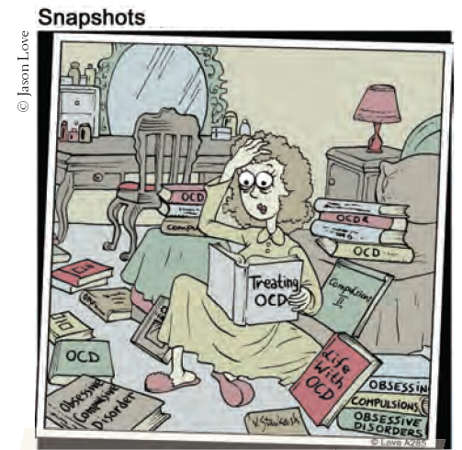
Obsessive-Compulsive Disorder [OCD]
Obsessions are intense, unwanted worries, ideas, and images that repeatedly pop up in the mind.
A compulsion is a repeatedly strong feeling of “needing” to carry out an action, even though it doesn’t feel like it makes sense.
When is it a “disorder”?
Distress: when you are deeply frustrated with not being able to control the behaviors
or
Dysfunction: when the time and mental energy spent on these thoughts and behaviors interfere with everyday life
Notes:
Why is OCD considered an anxiety disorder? Because obsessions can be a distraction from underlying anxiety, and compulsions worsen through a cycle of negative reinforcement related to anxiety. The OCD sufferer resists carrying out a compulsion, feels anxious, and ultimately relieves the anxiety by giving in to the compulsion.

Slide 17
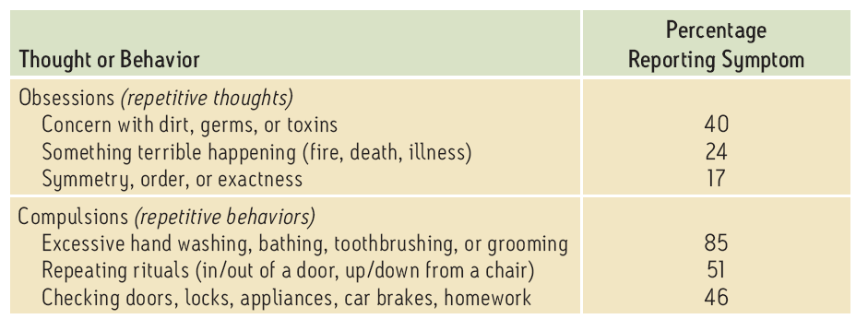
Common OCD Behaviors
Percentage of children and adolescents with OCD reporting these obsessions or compulsions:
Common pattern: RECHECKING Although you know that you’ve already made sure the door is locked, you feel you must check again. And again.
Notes:
Emphasize the concept of “again.” Doing one of these behaviors does not mean that you have OCD. You are more likely to get a higher level of distress or dysfunction when you keep having these thoughts or behaviors, even when it makes no sense to you and you want to stop, but feel too much anxiety when you try to stop the compulsions and feel that the obsessions are outside of your control.

Slide 18
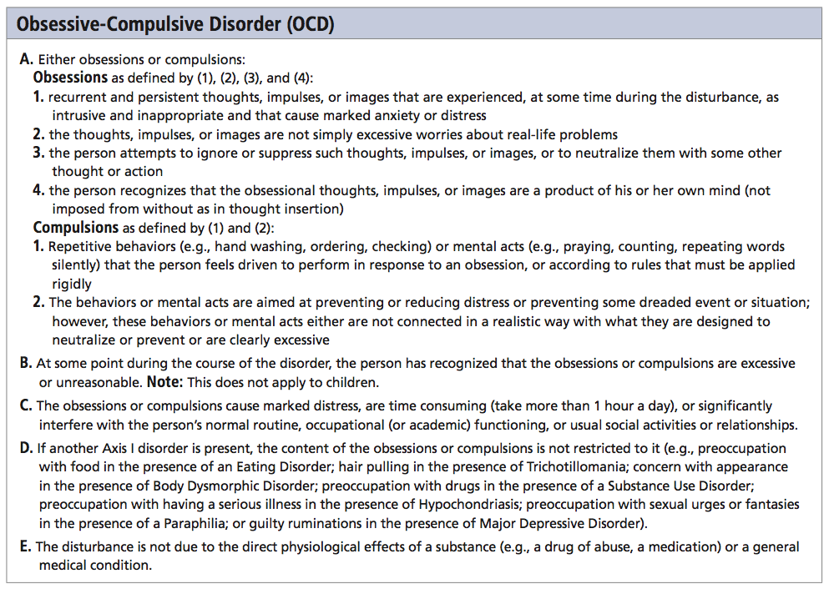

Slide 19
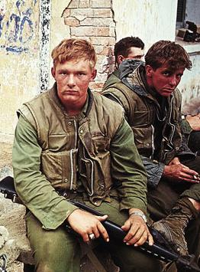
Post-Traumatic Stress Disorder [PTSD]
About 10 to 35 percent of people who experience trauma not only have burned-in memories, but also four weeks to a lifetime of:
repeated intrusive recall of those memories.
nightmares and other re-experiencing.
social withdrawal or phobic avoidance.
jumpy anxiety or hypervigilance.
insomnia or sleep problems.
Notes:
The greater ones emotional distress during the trauma, the higher risk for PTSD. .
Instructor: point out that PTSD is not just an outcome of war experience. Overwhelming trauma happens to people in all walks of life.
Why is PTSD classified as an anxiety disorder? The overall experience may look like spacey withdrawal and occasional jumpiness from the outside. However, inside there is tension, turmoil, worry, fear, dread, angst, stress, and re-living the feelings of the trauma itself, which is likely to be anxiety and related reactions to threat.

Slide 20
Mood Disorders

Slide 21
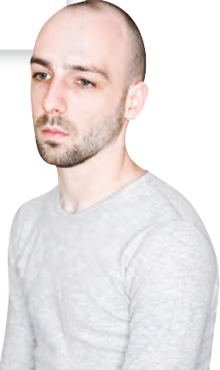
Mood Disorders
Major depressive disorder [MDD] is:
more than just feeling “down.”
more than just feeling sad about something.
Bipolar disorder is:
more than “mood swings.”
depression plus the problematic overly “up” mood called “mania.”

Slide 22
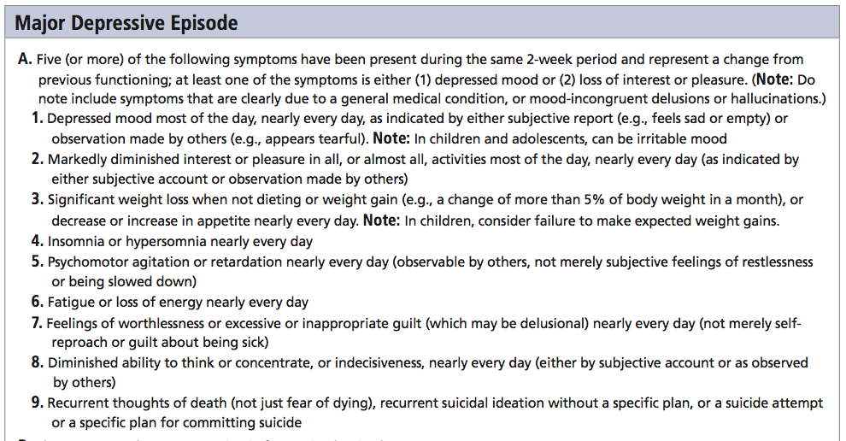
Major Depressive Episode: DSM Criteria
Notes:
Major depressive disorder is not just one of these symptoms.
It is one or both of the first two, PLUS three or more of the rest.

Slide 23
Depression is Everywhere
Depression shows up in people seeking treatment:
Phobias are the most common (frequently experienced) disorder, but depression is the #1 reason people seek mental health services.
Depression appears worldwide:
Per year, depressive episodes happen to about 6 percent of men and about 9 percent of women.
Over the course of a lifetime, 12 percent of Canadians and 17 percent of Americans experience depression.
Notes:
Anhedonia
Avolition

Slide 24

Seasonal Affective Disorder [SAD]
Seasonal affective disorder is more than simply disliking winter.
Seasonal affective disorder involves a recurring seasonal pattern of depression, usually during winter’s short, dark, cold days.
Survey: “Have you cried today”? Result: More people answer “yes” in winter.
 | Percentage who cried
 | Men | Women
August | 4 | 7
December | 8 | 21

Slide 25
Bipolar Disorder
Bipolar disorder was once called “manic-depressive disorder.”
Bipolar disorder’s two polar opposite moods are depression and mania.
Mania refers to a period of hyper-elevated mood that is euphoric, giddy, easily irritated, hyperactive, impulsive, overly optimistic, and even grandiose.
Contrasting Symptoms
Depressed mood: stuck feeling “down,” with: | Mania: euphoric, giddy, easily irritated, with:
exaggerated pessimism social withdrawal lack of felt pleasure inactivity and no initiative difficulty focusing fatigue and excessive desire to sleep | exaggerated optimism hypersociality and sexuality delight in everything impulsivity and overactivity racing thoughts; the mind won’t settle down little desire for sleep
Notes:
A typical pattern is three to seven weeks of depression, followed by three to seven DAYS of mania. People enjoying their mania often forget or deny that the manic phase leads back into depression.
Like depression, this euphoria is self-sustaining; in mania, it’s not that you’re happy about something.

Slide 26
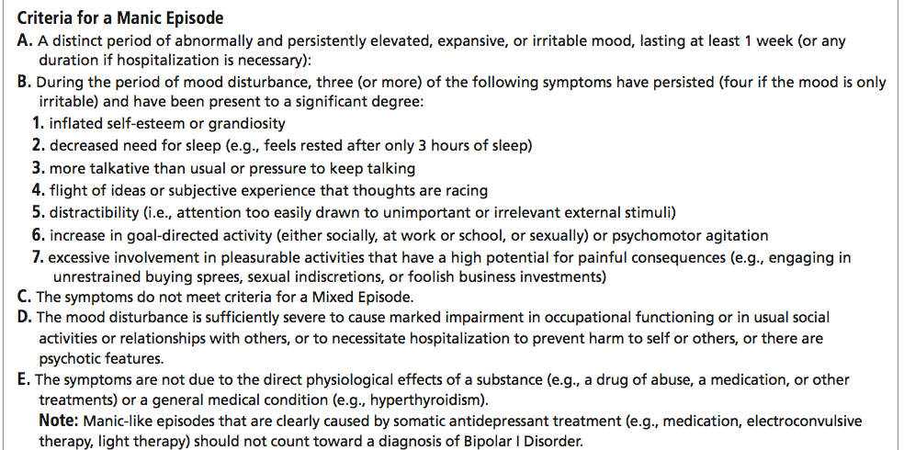
Manic Episode: DSM Criteria

Slide 27
Understanding Mood Disorders
Biological aspects and explanations
Evolutionary
Genetic
Brain /Body
Social-cognitive aspects and explanations
Negative thoughts and negative mood
Explanatory style
The vicious cycle

Slide 28

Biology of Depression: Evolution
Depression, in its milder, non-disordered form, may have had survival value.
Under stress, depression is social-emotional hibernation. It allows humans to:
conserve energy.
avoid conflicts and other risks.
let go of unattainable goals.
take time to contemplate.
Notes:
This information is presented in the book earlier in the chapter, but it also fits here.
However, students might consider that from an evolutionary perspective, it seems just as likely that depression serves no survival purpose, as evidenced by suicide, and is in the process of being eliminated by natural selection.

Slide 29
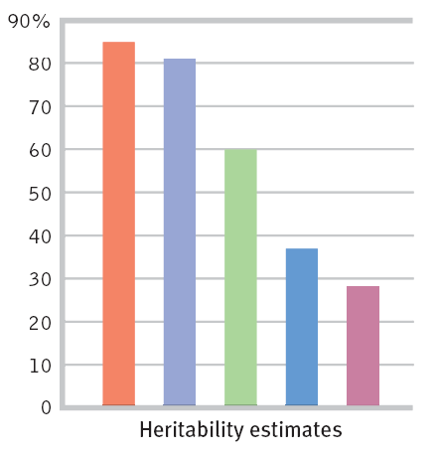
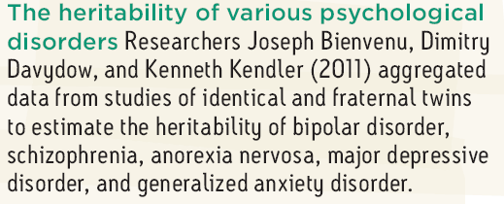
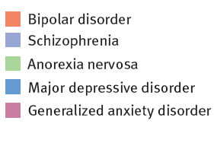
Biology of Depression: Genetics
Evidence of genetic influence on depression:
DNA linkage analysis reveals depressed gene regions
twin/adoption heritability studies
Notes:
DNA linkage analysis shows that regions of chromosomes are similar across generations of people in depressed families Another genetic factor to mention here, though it doesn't come up in the text until the discussion of neurotransmitters (p. 629): people with depression had a variation of a serotonin-controlling gene, although the text notes that this result may not be reliable.
Regarding the chart, see if students can recall the definition of heritability from the chapter on intelligence. Remind them that 80 percent heritability does NOT mean that genes are 80 percent of the cause of schizophrenia, as we shall soon see; it means that 80 percent of the variation among people is caused by genes.

Slide 30
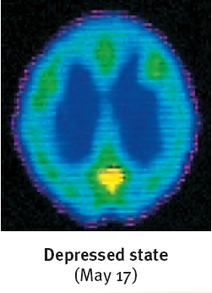
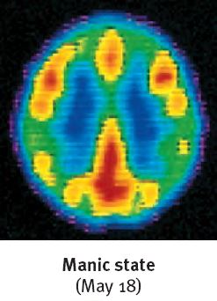
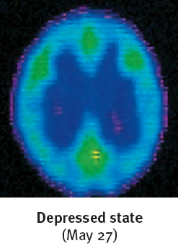
Biology of Depression: The Brain
Brain activity is diminished in depression and increased in mania.
Brain structure: smaller frontal lobes in depression and fewer axons in bipolar disorder
Brain cell communication (neurotransmitters):
more norepinephrine (arousing) in mania, less in depression
reduced serotonin in depression
Notes:
Frontal lobe = reward center
Fewer axons, less white matter, and larger ventricles (fluid filled areas in the center of the brain) point to a problem in having different parts of the brain work together smoothly.

Slide 31
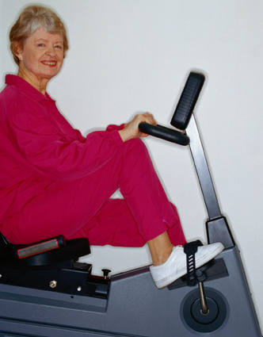
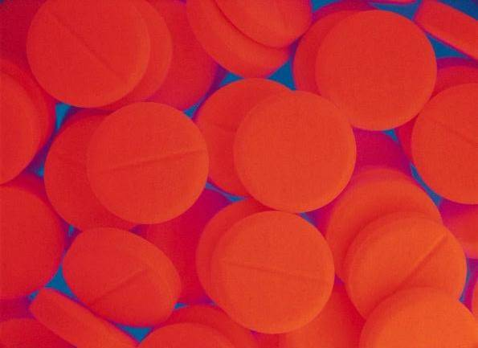


Preventing or Reducing Depression: Using Knowledge of the Biology of Depression
Adjust neurotransmitters with medication.
Increase serotonin levels with exercise.
Reduce brain inflammation with a healthy diet (especially olive and fish oils).
Prevent excessive alcohol use .
Notes:
Some medications, such as Wellbutrin try to reduce depression by increasing norepinephrine; other medications, such as Prozac, Zoloft, and Celexa increase the availability of serotonin.
Exercise has other benefits related to depression.
This is the “Mediterranean” diet, although some people try to get the benefits of this diet by taking Omega 3 supplements.
Alcohol abuse its related not only to biological changes but also to problems in behavior and coping skills.

Slide 32
Understanding Mood Disorders: The Social-Cognitive Perspective
Discounting positive information and assuming the worst about self, situation, and the future
Low Self-Esteem
Self-defeating beliefs such as assuming that one (self) is unable to cope, improve, achieve, or be happy
Learned Helplessness
Depression is associated with:
Depressive Explanatory Style
Rumination
Stuck focusing on what’s bad
Notes:
Discounting the positive: “You’re only spending time with me because you feel sorry for me.”
Depression is also associated with cognitive errors, such as assuming one can know the future or the thoughts of others.

Slide 33
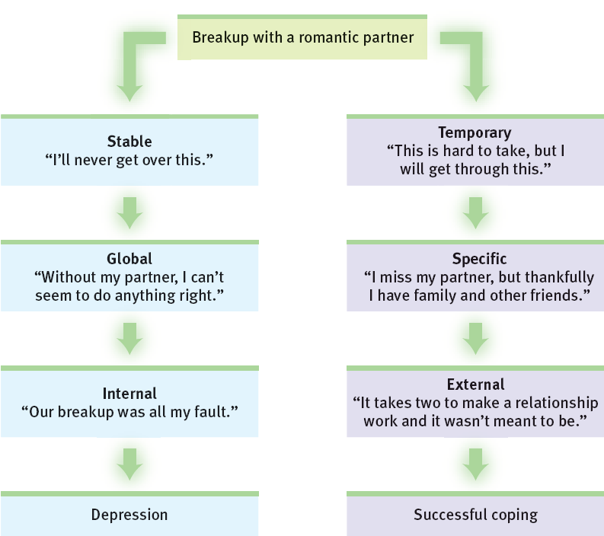
Depressive Explanatory Style
How we analyze bad news predicts mood.
Problematic event:
Assumptions about the problem
The problem is:
The problem is:
The problem is:
Mood/result that goes along with these views:
Notes:
This chart implies that the negative explanatory style leads to depression. However, as the next chart will show, depression makes it more likely to make cognitive problems such as this negative attributional style.
As Martin Seligman has suggested (quote in the text), depression can be caused by “preexisting pessimism encountering failure.”
Global Stable Internal vs Specific Temporary External
Explanatory Styles and Depression
Global vs Specific
Stable vs Temporary
Internal vs External

Slide 34
Schizophrenia

Slide 35

Schizophrenia:
the mind is split from reality, e.g. a split from one’s own thoughts so that they appear as hallucinations.
Psychosis refers to a mental split from reality and rationality.
Schizophrenia symptoms include:
disorganized and/or delusional thinking.
disturbed perceptions.
inappropriate emotions and actions.
Notes:
Literally, schizophrenia means “split mind,” but NOT split personality. The person who invented the term, Eugen Bleuler (1857-1939), spoke of a splintering of the functions governing thinking, perception, personality, and memory, although I would add emotion to that list. Most noticeable are the perceptual problems such as a split from REALITY.

Slide 36
Positive and Negative Symptoms of Schizophrenia
Positive + presence of problematic behaviors
Negative - absence of healthy behaviors
Hallucinations (illusory perceptions), especially auditory
Delusions (illusory beliefs), especially persecutory
Disorganized thought and nonsensical speech
Flat affect (no emotion showing in the face)
Reduced social interaction
Anhedonia (no feeling of enjoyment)
Avolition (less motivation, initiative, focus on tasks)
Alogia (speaking less)
Catatonia (moving less)
Notes:
Hallucination- sensory experience without sensory stimulation
They think they are being persecuted.
You can ask first, “which of these are negative symptoms?” Students have experienced this sense of the words “positive” and “negative” when talking about reinforcement, but it’s a difficult shift in word usage so it’s worth testing them on it here. Some of the symptoms, such as disorganized thought and catatonia, could arguably be placed in either column.

Slide 37
Schizophrenia Symptoms: Problems in Thinking and Speaking
Disorganized speech, including the “word salad” of loosely associated phrases
Delusions (illusory beliefs), often bizarre and not just mistaken; most common are delusions of grandeur and of persecution
Problems with selective attention, difficulty filtering thoughts and choosing which thoughts to believe and to say out loud
? ! ? !
? ! ? !

Slide 38
Schizophrenia Symptoms: Disturbed Perceptions
You’re evil!
Am I evil?
People with schizophrenia often experience hallucinations, that is, perceptual experiences not shared by others.
The most common form of hallucination is hearing voices that no one else hears, often with upsetting (e.g. shaming) content.
Hallucinations can also be visual, olfactory/smells, tactile/touch, or gustatory/taste.
Notes:
There is recent evidence that hallucinations in schizophrenia are caused in part because there is dysfunction in the parts of the brain that identify what is self vs. what is external. Thus, the fleeting ideas in the thought balloon might trigger, not just follow, the “heard” words about being evil.

Slide 39
Schizophrenia Symptoms: Inappropriate Emotions
Odd and socially inappropriate responses such as looking bored or amused while hearing of a death
Flat affect: facial/body expression is “flat” with no visible emotional content
Impaired perception of emotions, including not “reading” others’ intentions and feelings

Slide 40
Onset and Development of Schizophrenia
Course of Schizophrenia
Acute/Reactive Schizophrenia In reaction to stress, some people develop positive symptoms such as hallucinations.
Recovery is likely.
Chronic/Process Schizophrenia develops slowly, with more negative symptoms such as flat affect and social withdrawal.
With treatment and support, there may be periods of a normal life, but not a cure.
Without treatment, this type of schizophrenia often leads to poverty and social problems.
Onset: Typically, schizophrenic symptoms appear at the end of adolescence and in early adulthood, later for women than for men.
Prevalence: Nearly 1 in 100 people develop schizophrenia, slightly more men than women.
Development: The course of schizophrenia can be acute/reactive or chronic.
Notes:
“Course” means the development of symptoms over time.
Treatment can include not only medication but psychosocial rehabilitation, exercise, psychotherapy, supervised group homes, case management, daily living skills support, and vocational programs.
Without real treatment, institutionalization was once the norm, then homelessness and incarceration, now outpatient treatment and “partial hospitalization” (day treatment).

Slide 41
Subtypes of Schizophrenia
Paranoid
Disorganized
Catatonic
Undifferentiated
Residual
Plagued by hallucinations, often with negative messages, and delusions, both grandiose and persecutory
Primary symptoms are flat affect, incoherent speech, and random behavior
Rarely initiating or controlling movement; copies others’ speech and actions
Many varied symptoms
Withdrawal continues after positive symptoms have disappeared
Notes:
The previous slide showed two types of course: acute/reactive and chronic/process. This slide differentiates types of schizophrenia by the pattern of symptoms.
Paranoid schizophrenia is the most common and the most likely to be known to students. The symptoms go together as the individual experiences brain-generated perceptions that seem as real as sensory experiences. Often the delusions are an attempt to explain these hallucinations; “thoughts are being broadcast into my head so I must have a special power or role in the world.”

Slide 42
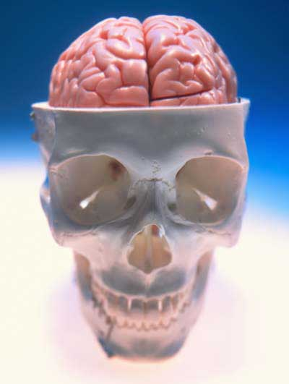
Understanding Schizophrenia
What’s going on in the brain in schizophrenia?
Abnormal brain structure and activity
Too many dopamine/D4 receptors leads to paranoia and hallucinations; it’s like taking amphetamine overdoses all the time.
Poor coordination of neural firing in the frontal lobes impairs judgment and self-control.
The thalamus fires during hallucinations as if real sensations were being received.
There is general shrinking of many brain areas and connections between them.
Notes:
Students may need reminding that the thalamus was referred to earlier in the course as the sensory switchboard.
There is also abnormal amygdala functioning in schizophrenia, which could be a result of schizophrenia or could explain the hyper-sensitivity to threat that could feed into paranoid ideas and aggressive reactive behavior.
In addition to the shrinkage of the brain tissue, enlargement of the ventricles (fluid-filled areas within and between areas of tissue) can be seen.

Slide 43
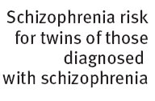
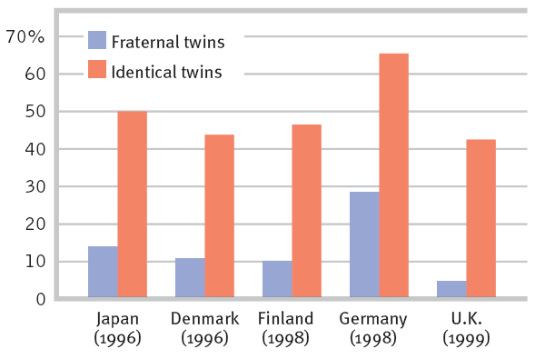
Understanding Schizophrenia
Are there genetic risk factors? If so, we would see more similar schizophrenia risk shared between identical twins than fraternal twins (graph below). Do we?
Genetic Factors
If one twin has schizophrenia, the chance of the other one also having it are much greater if the twins are identical.
Having adoptive siblings (or parents) with schizophrenia does not increase the likelihood of developing schizophrenia.
Notes:
Questions to raise here: what does this tell us about the role of genes in schizophrenia? They must play some role, because having more genes in common means more similar likelihood of developing schizophrenia.
Preview of the next slide, or in place of it: why is the risk not identical for identical twins? It could be environmental factors. Or, it could be a difference beginning even sooner (not sharing a placenta).

Slide 44
Therapy

Slide 45
Current Forms of Therapy
Psychotherapy:
an interactive experience with a trained professional, working on understanding and changing behavior, thinking, relationships, and emotions
Biomedical therapy:
the use of medications and other procedures acting directly on the body to reduce the symptoms of mental disorders
Combining Therapies
There are various forms of psychotherapy.
An eclectic approach uses techniques from various forms of therapy to fit the client’s problems, strengths, and preferences.
Medications and psychotherapy can be used together, and may help the each other achieve better reduction in symptoms.

Slide 46
Psychological Treatment
Psychotherapy
Psychoanalytic/Psychodynamic
Humanistic
Cognitive
Cognitive-behavioral
Biomedical therapy
Drugs
Neurostimulation

Slide 47
Psychoanalytic/Psychodynamic Therapy
Goals
Reduce inner conflict by giving patients insight into their unconscious thoughts and feelings
Reveal how childhood experiences have shaped the individual
Notes:
Psychodynamic therapists don’t talk much about id, ego, and superego. Instead they try to help people understand their current symptoms. They focus on themes across important relationships, including childhood experiences and the therapist relationship.

Slide 48
Humanistic Therapy: Client-centered Therapy
Goal: boost people’s self-fulfillment and promote self-growth
Focuses on the person’s conscious self-perceptions
Active Listening
Unconditional positive regard
Notes:
Instead of focusing on unconscious and repressed thoughts and impulses, ________ therapies focus on conscious thoughts and self-perceptions.
1) In this nondirective therapy, the therapist listens, without judging or interpreting, and seeks to refrain from directing the client toward certain insights.
2) active listening—echoing, restating, and seeking clarification of what the person expresses (verbally or nonverbally) and acknowledging the expressed feelings.
3) unconditional positive regard- a caring, accepting, nonjudgmental attitude

Slide 49
Behavior Therapies
Goal: Replace maladaptive (learned) symptoms—such as phobias —with new constructive behaviors.
Example:
Exposure therapies
Systematic desensitization
Virtual reality exposure
Aversive conditioning
Notes:
Counterconditioning- pairs the trigger stimulus with a new response
systematic desensitization: a type of exposure therapy that associates a pleasant relaxed state with gradually increasing anxiety-triggering stimuli. Commonly used to treat phobias.
virtual reality exposure therapy: an anxiety treatment that progressively exposes people to electronic simulations of their greatest fears, such as airplane flying, spiders, or public speaking. (p. 682)
aversive conditioning: a type of counterconditioning that associates an unpleasant state (such as nausea) with an unwanted behavior (such as drinking alcohol).

Slide 50
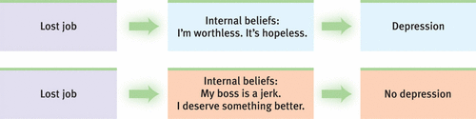
Cognitive Therapies
Goal: Teach people new, more constructive ways of thinking and feeling
Overcoming self-defeating thoughts
Notes:
+ Dialectical behaviour theory

